Slide 1
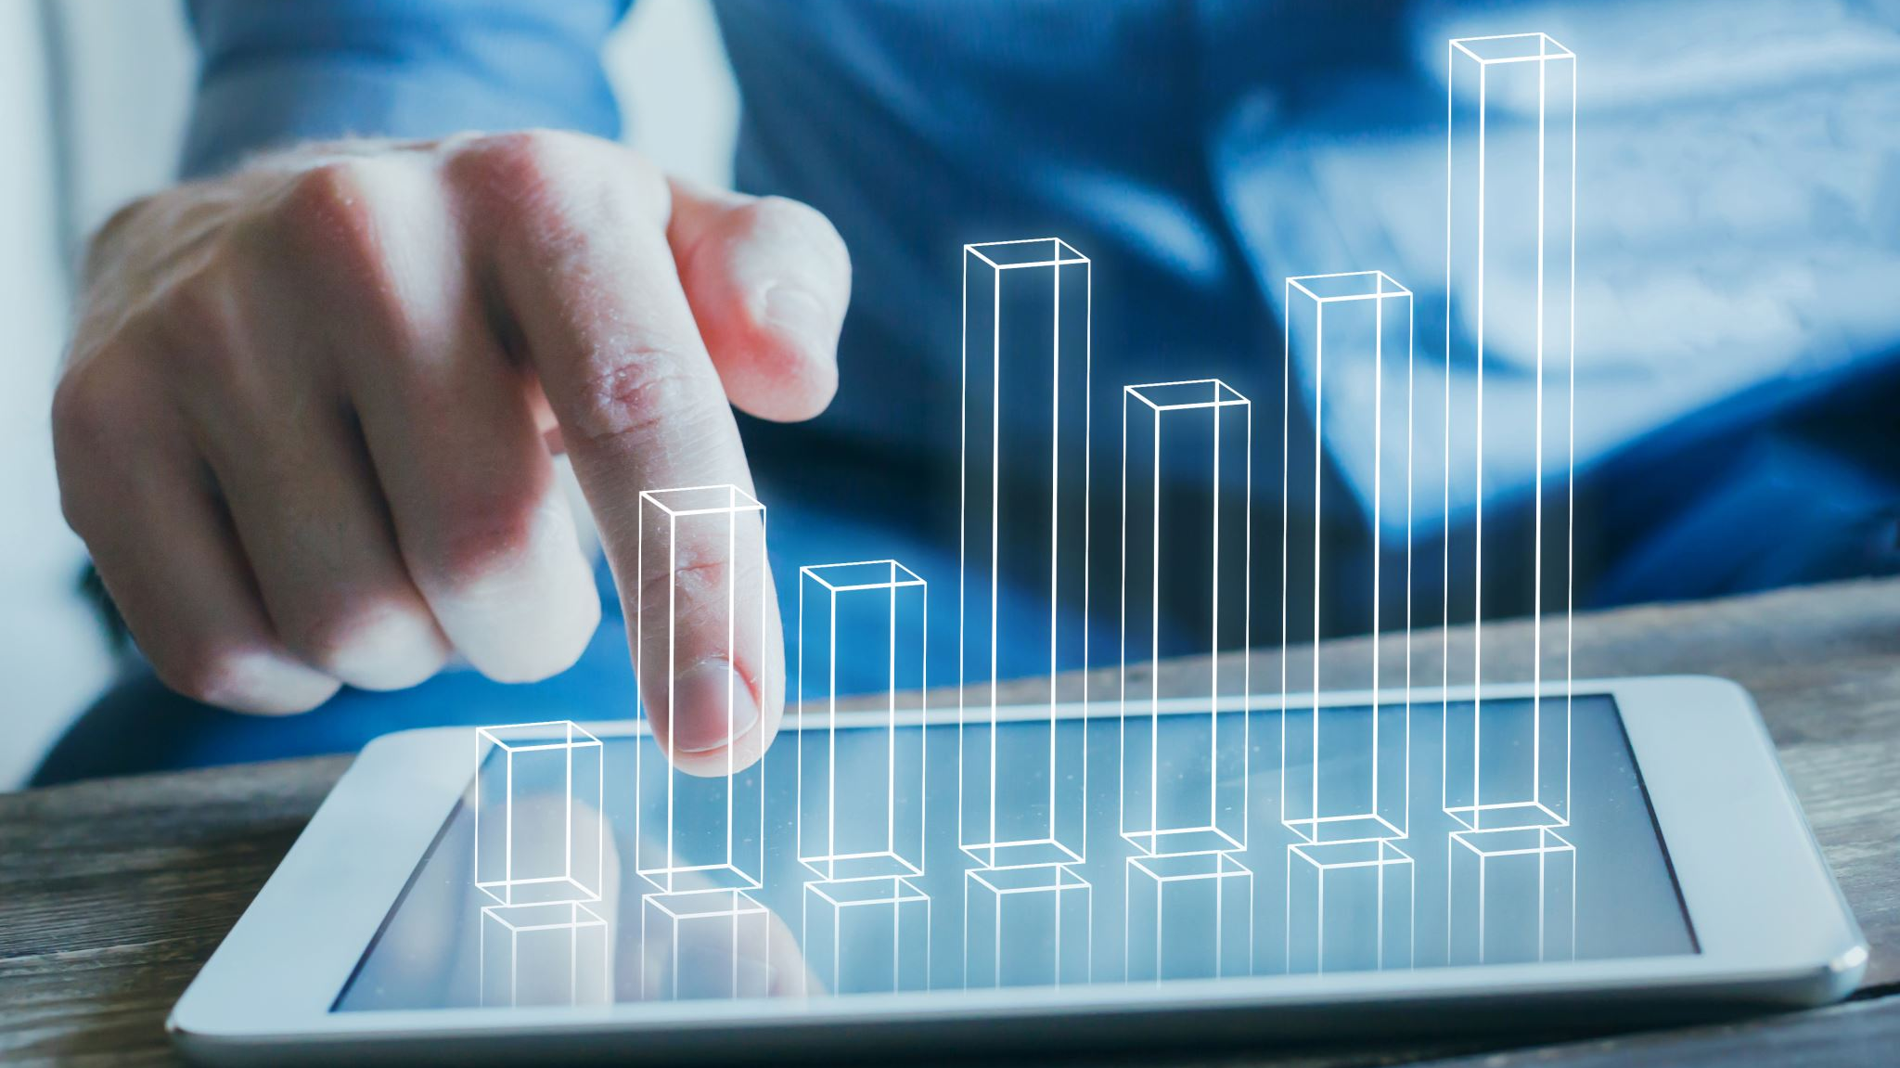
OC Team - LinkedIn Analytics

Slide 2
Page Visitors

Slide 3

Page Visitors Insights: Unique Visitors through device and sub-page visitors
The LinkedIn Life Page is a storytelling space on our company’s LinkedIn profile that showcases our culture, people, and workplace experience - helping attract talent, engage partners, and strengthen your brand identity. But on our life page, we do not have any visitors. So, we need to focus on creating content related to the company culture or employees
Desktop viewers are more than mobile viewers which suggests people are focused on more information content or posts rather than just scrolling
Also, dominant desktop visitors suggest our viewers are business professionals or decision makers who use LinkedIn as a business tool

Slide 4
Total Views by Location and Job Function
Maximum viewers are from LA which is I think so relevant to our team
Visitors who are viewing our page most of them are working in Marketing, Arts & Design, Operations, Education and Media & Communication. So, which I think we are attracting relevant audience through our posts

Slide 5
Industry vs Total Views

Slide 6
Followers Analysis

Slide 8

Follwers Insights: Growth & Location
Maximum followers are from LA, so our page visitors are indeed highest from the LA location
We need to diversify our followers to increase our brand visibility and reach by posting different content based on the various conferences or events attended in various states by also tagging the specific event name
Total followers increased in the month of July and August (need to check the relevant post on these dates, which led to a boost in our total followers

Slide 9
Followers by Job Function

Slide 10
Followers by Seniority and Company Size

Slide 11
Followers Insights
From the auto-invited feature of LinkedIn, we have received a total of approx 50 new followers (in 90 days), and all the auto-invited followers accepted the follow request
So, we have a feature in LinkedIn that we can see who those people are who were auto-invited, and we can reach out to them regarding our event or marketing. As I have seen, some of them are in a good position in the industry
Also, from our seniority page data, we have connections who are VP, Director, Manager, Owner, and Co-founder, whom we can cold message and look out for increasing our business
Regarding new followers, I could see a boost in the organic followers between 22 July - 28 July 2025 (Max was on 24 July). Also, it increased again in the month of August, from August 5th to August 11th. So, I am not sure what made this boost, as during this period, there were two posts, and it has an increased number of impressions and click through rate.

Slide 12
Engagement Rate & CTR
Engagement Rate | Interpretation
<2% | Low – Content not resonating
2–5% | Average – Good, consistent performance
5–10% | Strong – Audience is actively engaging
>10% | Excellent – Highly relevant or viral content
Type of Content | Average CTR | High-Performing CTR | Low CTR
Organic Posts | 0.5% – 2% | 2%+ | < 0.5%
Sponsored Content / Ads | 0.35% – 0.8% | 1%+ | < 0.3%
Text or Image Posts (no link) | 1% – 3% | 3%+ | < 1%
Video Posts | 0.4% – 1.0% | 1.5%+ | < 0.4%
Carousel / Document Ads | 0.6% – 1.2% | 1.5%+ | < 0.5%

Slide 13
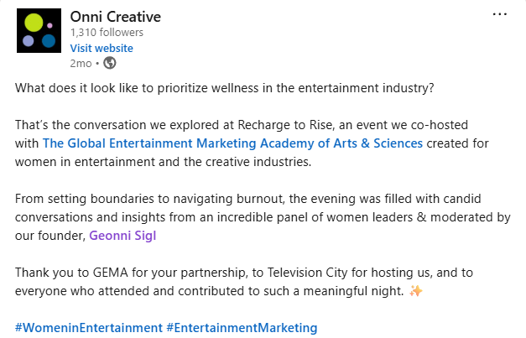
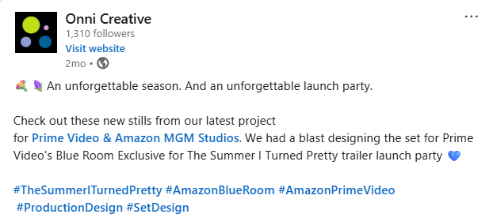
Content Insights
In 90 days, only 9 posts were there on LinkedIn. So, I would suggest that to increase the engagement of the audience and improve visibility, we should post frequently about various events, conferences, or seminars that we attend If we have received a sponsorship for designing promotional items or goodies for any distributor, we can post that stuff if that item has been a best seller, by increasing audience engagement towards the movie The below 2 posts have the highest CTR and ER compared to all other posts in the 90 days period.

